Slide 1

Database Management System Final Project
The Database Group

Slide 2
TABLE OF CONTENTS
01.
02.
04.
05.
Introduction to the team.
Introduction to our Database mini world.
03.
A glimpse of our EER.
Description of the EER.
Description of EER in mySQL workbench.
06.
Demo

Slide 3

01.
Introduction to the team

Slide 4





THE DATABASE GROUP
Nabinta Niraula
Victoria Grillo
Samrina Dhami
Tyler Hight
Biraj Thapa

Slide 5

Introduction to database mini world
02..

Slide 6
BANKING
Why:
Interested in money and banking operations.
Purpose:
To manage and streamline the daily operations of a bank.
For:
Customers, employees, managers, accounts, and departments.
Goal:
Enable smooth banking operations, maintain accurate financial records, and ensure efficient customer service.

Slide 7
Components: Employees, Customers, Accounts, Departments, Manager
Employee Attributes: SSN, Name, Salary, Department Number, Type (Loan Officer or Teller)
Customer Attributes: SSN, Cell Phone Number, Address, Name
Account Attributes: CID, CuSSN, Department Number
Transaction Records Attributes: Amount (Checking and Savings), Date
Manager Attributes: SSN, Salary, Department Number, Branch
Relationships: Employee-Department, Customer-Account, Account-Transaction Records, Manager-Employee

Slide 8
EER DIAGRAM
03.

Slide 9
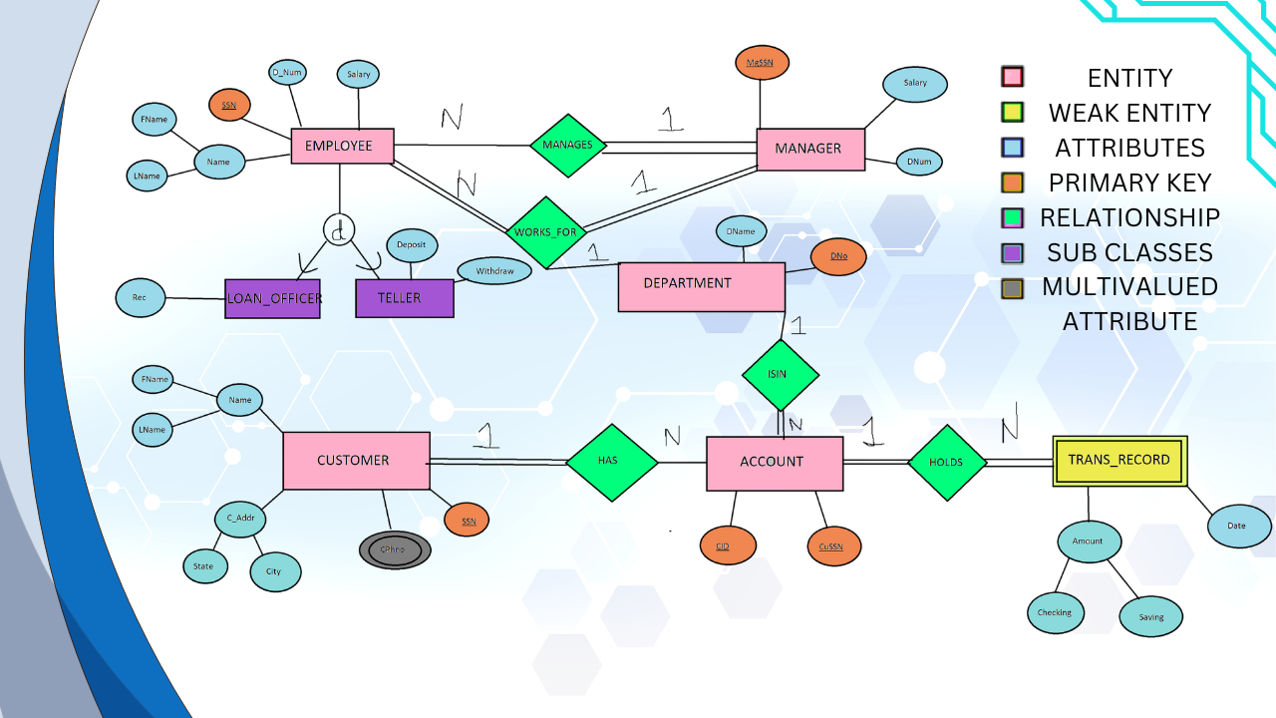

Slide 10
EER DIAGRAM IN SQL
04.

Slide 11
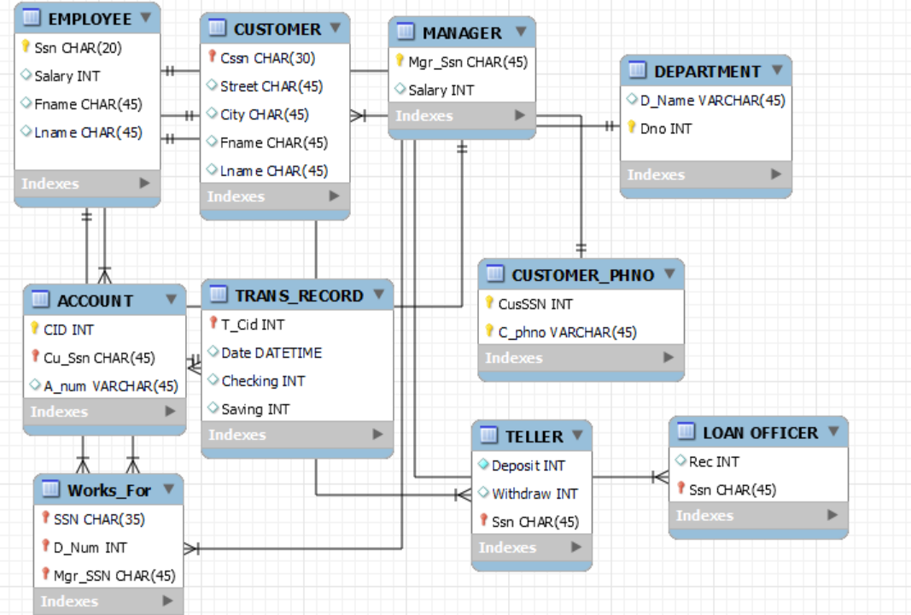
OUR PHILOSOPHY
Jupiter
Venus
Saturn
It’s the biggest planet
in the Solar System
Venus has a beautiful name, but it’s hot
Saturn is a gas giant with several rings

Slide 12
Description of EER
05.

Slide 13
Entity-Relationship (ER) Model for Banking System
1. Regular entities:
EMPLOYEE (SSN, FName, LName, D_Num, salary, type)
CUSTOMER (CSSN, FName, LName, C_Addr, State, City, C_Phno)
MANAGER (MgrSSN, FName, LName, D_Num, salary)
ACCOUNT (CID, Cu_SSN, D_Num)
DEPARTMENT (DNO, DName, MgrSSN)
2. Weak entity:
TRANS_RECORD (TID, CID, amount, date)
3. Binary 1:N relationships:
MANAGES
HAS
HOLDS
ISIN
4. Multivalued attribute:
C_Phno (mapped as CUSTOMER_PNUM)
5. N-ary relationship:
WORKS_FOR
6. Specialization:
LOAN_OFFICER (SSN, FName, LName, D_Num, salary, Record)
TELLER (SSN, FName, LName, D_Num, salary, deposit, withdraw)

Slide 14
DEMO
06.

